Slide 1
Pearsons BTEC in I.T.
Duration: 2 years
Number of units to complete: 4
Written examinations: 2
Coursework units: 2
’The future awaits……the future is now……’
Contact: Mr O’ Brien
Email: aobrien516@c2ken.net

Slide 2
Overview Requirements: there are no prior learning requirements for this course currently
The Pearson Level 3 qualification in IT will suit pupils who enjoy IT and are looking for a career in the IT sector. This is a new qualification that combines the creativity of coursework along with the challenge of exams.
The course aims to develop skills in web design, database management, social media as well as learning the core concepts of IT systems. This qualification will provide the pathway for those students looking to begin a career in web application development, software analyst and design, cybersecurity or systems administration. Within the qualification students complete four units, two of which are compulsory are examined by a written examination with the other two units being coursework based.
Contact: Mr O’ Brien
Email: aobrien516@c2ken.net

Slide 3
Overview Requirements: there are no prior learning requirements for this course currently
Computers are widely used in all aspects of business, industry, government, education, leisure and the home. In this increasingly technological age, a study of computing , and particularly how computers are used in the solution of a variety of problems, is not only valuable to the learners but also essential to the future well-being of the country.
Computing integrates well with subjects across the curriculum. It demands both logical discipline and imaginative creativity in the selection and design of solutions to problems; it encourages an awareness of the management and organisation of computer systems; it extends the learners’ horizons beyond the school or college environment in the appreciation of the effects of computing on society and individuals. For these reasons, computing is as relevant to a learner studying arts subjects as it is to one studying science subjects.
Contact: Mr O’ Brien
Email: aobrien516@c2ken.net

Slide 4
Careers
Careers: There are many careers options that a person can explore from choosing Computing as an option at A Level.
These careers include:
Software Engineering
Data Analysis
Systems Administrator
App developer
Cyber Security
Forensic IT Analyst
…. plus a whole lot more……
Contact: Mr O’ Brien
Email: aobrien516@c2ken.net

Slide 5
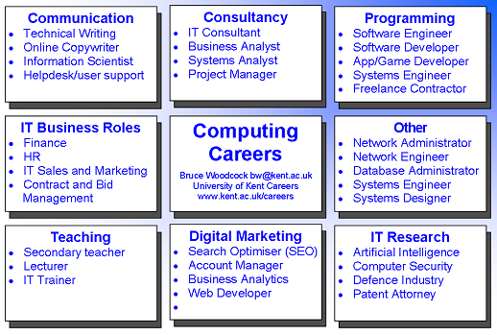

Slide 6
Assessment The work for each unit is graded as either : Pass (E Grade) Merit (C Grade) Distinction (A Grade).
In Lower Sixth students will complete two units:
Unit 1: Information Technology Systems – Strategy, Management and Infrastructure
Unit 3: Using Social Media in Business
Unit 1: Information Technology Systems
Unit in brief: Learners study the role of computer systems and the implications of their use in personal and professional situations. Learners will explore the relationships between the hardware and software that form an IT system. Learners will look at the way that systems work individually and together, as well as the relationship between the user and the system. Learners will examine issues related to the use of IT systems and the impact that they have on organisations and their stakeholders. Learners will explore how IT systems enable organisations to access data, information and users locally and globally.
Contact: Mr O’ Brien
Email: aobrien516@c2ken.net

Slide 7
Assessment The work for each unit is graded as either : Pass (E Grade) Merit (C Grade) Distinction (A Grade).
In Lower Sixth students will complete two units:
Unit 1: Information Technology Systems – Strategy, Management and Infrastructure
Unit 3: Using Social Media in Business
Unit 3: Social Media in Business
Unit in brief: Learners will explore different social media websites, the ways in which they can be used and the potential pitfalls when using them for business purposes. Learners will develop a plan to use social media strategies for business purposes to achieve specific aims and objectives. Learners will then implement the plan, developing and posting content and interacting with others. Finally, learners will collect data on the business use of social media and review the effectiveness of the learners’ efforts.
Contact: Mr O’ Brien
Email: aobrien516@c2ken.net

Slide 8
Assessment The work for each unit is graded as either : Pass (E Grade) Merit (C Grade) Distinction (A Grade).
In Upper Sixth student will complete a further two units:
Unit 2: Creating Systems to Manage Information
Unit 6: Website Development
Unit 2: Creating Systems to Manage Information
Unit in brief: Learners will examine the structure of data and its origins, and how an efficient data design follows through to an effective and useful database. Learners will examine a given scenario and develop an effective design solution to produce a database system. Learners will then test your solution to ensure that it works correctly. Finally, learners will evaluate each stage of the development process and the effectiveness of your database solution. To complete the assessment tasks in this unit, learners will need to draw on their learning from across the programme.
Contact: Mr O’ Brien
Email: aobrien516@c2ken.net

Slide 9
Assessment The work for each unit is graded as either : Pass (E Grade) Merit (C Grade) Distinction (A Grade).
In Upper Sixth student will complete a further two units:
Unit 2: Creating Systems to Manage Information
Unit 6: Website Development
Unit 6: Web Design
Unit in brief: In this unit, learners will review existing websites – commenting on their overall design and effectiveness. Learners will use scripting languages such as Hypertext Markup Language (HTML), Cascading Style Sheets (CSS) and JavaScript® and a simple text editor, or rapid application development tools. Finally, learners will reflect on the website design and functionality using a testing and review process.
Contact: Mr O’ Brien
Email: aobrien516@c2ken.net

Slide 10
For any further enquiries please contact Mr O’ Brien
Email: aobrien516@c2ken.net

